Slide 2
Platformen
Windows Active Directory Domain
en Windows gebruikers en groepen

Slide 3
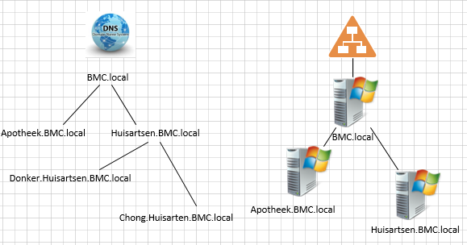
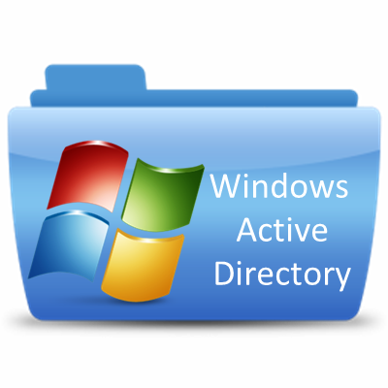
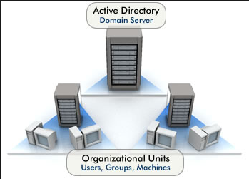
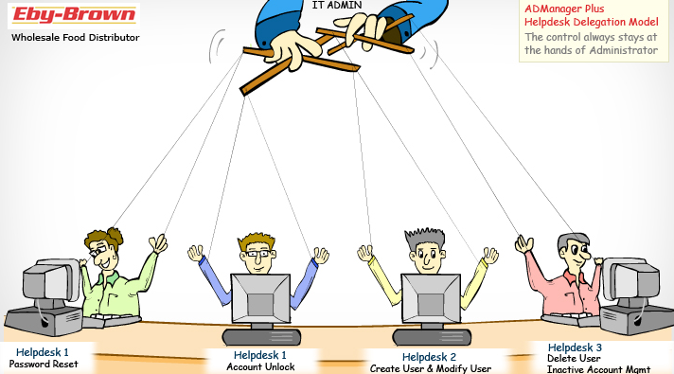
Active Directory
Central LDAP database;
Gebruikers, groepen, computers;
DNS;
Beheer / controle.
Notes:
LDAP: Lightweight Directory Access Protocol. Doordat dit de basis vormt van AD worden binnen AD schema (de beschrijving van de structuur van de data die in de directory kan worden opgeslagen) en objects (alles wat in de directory wordt opgeslagen, de daadwerkelijke data zit in attributes van de objecten) onderscheiden.
Bronvermelding illustraties: bovenaan, eigen werk; midden links, overgenomen van https://www.clipartmax.com/middle/m2H7K9A0b1b1H7Z5_directory-service-icon-windows-active-directory-icon/ binnen fair use; midden rechts, overgenomen van http://www.bostonsolux.com/?project=active-directory-design-implementations binnen fair use; onderaan, overgemoen van https://www.manageengine.com/products/ad-manager/case-study-active-directory-delegate-rights-reporting-tool-for-eby.html binnen fair use

Slide 4
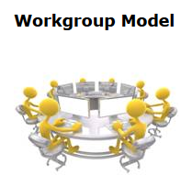
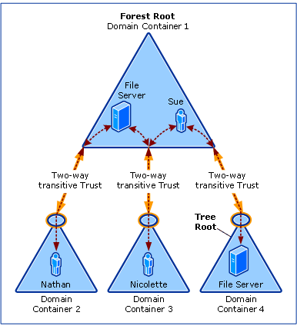

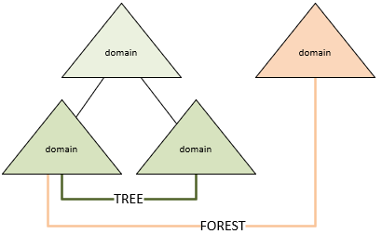
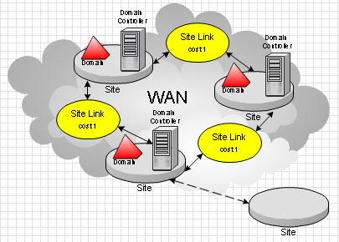
AD Basics
Workgroup / Client-server
Domain & Active Directory Domain services
Tree & Forest
Site, Replication & Schema
Global Catalog
Objects & Trusts
Group policy
Organizational Units
Notes:
Werkgroep vs domein: Een werkgroep heeft geen centrale, managementserver zoals een domein een DC heeft. Er is geen hiërarchische rolverdeling. Alle systemen in een werkgroep hebben dezelfde mogelijkheden en/of beperkingen (peer to peer). Als je een gebruikerswachtwoord op 1 van de PC’s wijzigt, dan wordt dat niet op andere PC’s in een werkgroep aangepast.
ADDS: de AD LDAP database met daaromheen tooling om deze te beheren en gebruiken
Tree vs Forest: Een forest is een ‘single instance’ van AD. Het forest kan uit 1 of meerdere domeinen bestaan. Een forest is een ‘security boundary’ voor gebruikers, groepen, objecten en computers. Een (domein)tree heeft een hoofddomein (contiguous namespace) en een gezamenlijk schema. Elke ‘boom’ kan meerdere takken (subdomeinen) hebben, elke tak heeft een eigen subdomein welke is afgeleid van het hoofddomein.
Site: een collectie van ‘well-connected’ subnets.
Replication: heeft in de context van een domein te maken met het repliceren van AD-objecten (gebruikers, wachtwoorden, printers, etc.) tussen meerdere DC’s
Global Catalog (GC): Een GC heeft een samenvatting van alle objecten in een domein en heeft beperkte informatie van objecten in een forest. Het doel van de GC is het verhogen van de prestaties.
Trusts: vertrouwensrelatie tussen verschillende domeinen. De relatie is ‘transitief’, dat wil zeggen: als A een vertrouwensrelatie heeft met B en B een vertrouwensrelatie met C, dan hebben A en C ook een vertrouwensrelatie.
Bronvermelding illustraties: linksboven, overgenomen van https://nl.depositphotos.com/12349746/stockafbeelding-3d-vergadering-van-de-werkgroep.html binnen fair use; daaronder, overgenomen van https://www.microsoft.com/en-us/p/group-policy-search/9nblggh08wvs binnen fair use; rechtsboven, overgenomen van https://www.usetheweb.ch/windows-server-2012-at-a-glance-part-1/ onder fair use; midden, bron onbekend; onder, overgenomen van https://www.conceptdraw.com/How-To-Guide/active-directory-diagram onder fair use;

Slide 5
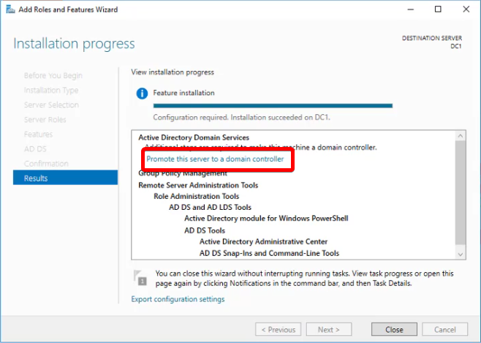
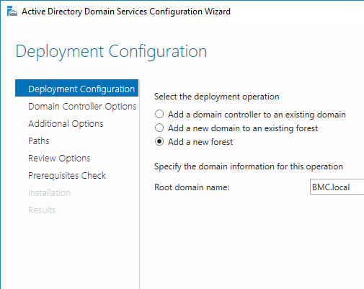
Creating AD
Installation ADDS
Promote Server
New / existing Forest
DFL, DNS & GC
NetBIOS name
Database Path
DSRM Password
Powershell & Reboot
Notes:
Bronvermelding illustraties: eigen werk (screenshots)
DSRM: Directory Services Restore Mode, een speciale modus waarin een DC gestart kan worden om AD data te restoren.

Slide 6
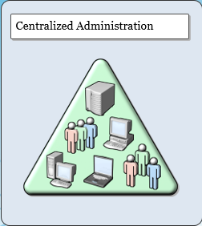
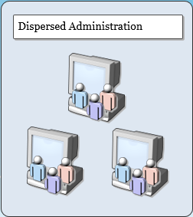
Benefits (single) AD domain
Central Management / Control;
Authentication;
Authorization;
User & computer;
AD applicaties (eg. Exchange);
Resources;
Security
Disaster recovery
Cost
Notes:
Disaster recovery: het uit AD terug proberen te krijgen van gegevens nadat er iets serieus mis is gegaan. De kans dat dit lukt is met een domein veel groter dan met een workgroup.
Bronvermelding illustraties: Microsoft cursusmaterialen (HU medewerker met Instructor status)

Slide 7
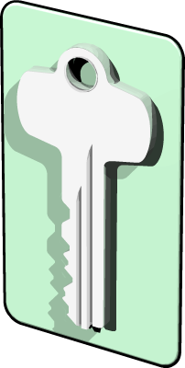
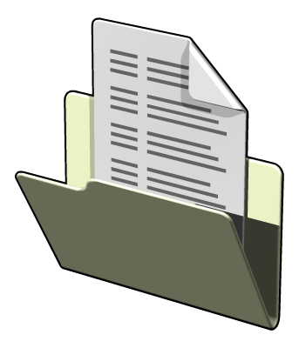
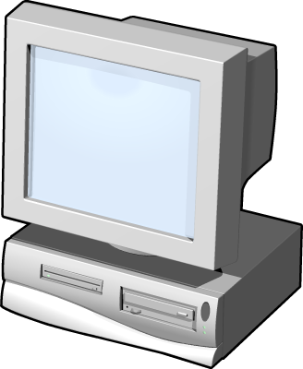
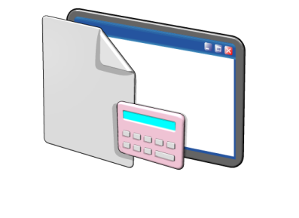
What is Authentication?
Authentication is the process of verifying a user’s identity on a network
Authentication includes two components:
Interactive logon – grants access to the local computer
Network authentication –grants access to network resources
Notes:
Consider using a passport as an analogy for authentication. It is a means by which a user can verify they are who they say they are.
The most common way for users to authenticate is by providing a user name and password. However, some computer systems also support authentication based on smart cards, one-time passwords, or biometric information, such as fingerprint scans.
References
Windows Authentication:
http://technet.microsoft.com/en-us/library/cc755284(WS.10).aspx
What's New for Identity Management in Windows Server 2008:
http://technet.microsoft.com/en-us/library/cc772438(WS.10).aspx
Bronvermelding illustraties: Microsoft cursusmaterialen (HU medewerker met Instructor status)

Slide 8
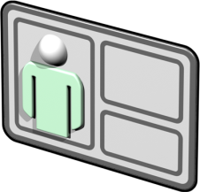







What is Authorization?
Authorization is a process of verifying that an authenticated user has permission to perform an action
Security principals are issued security identifiers (SIDs) when the account is created
User accounts are issued security tokens during authentication that include the user’s SID and all related group SIDs
Shared resources on a network include access control lists (ACL) that define who can access the resource
The security token is compared against the DACL on the resource and access is granted or denied
Notes:
What is a security principal and what types of network objects can be security principals.
Mention the types of attributes that might be contained in the security token. For example, user group, ownership, and admin privileges.
Mention that the security identifier (SID) attribute is unique for each user or security group, and is the primary means by which the security principal is identified when trying to access network resources.
Mention that authorization happens frequently and unobtrusively whenever users request services, like opening their home folder, reading/writing files, or when requesting access to an AD DS aware application. The user only sees the result of the authorization--they are granted or denied access.
Mention tools like Active Directory Users and Computers for managing security principals.
References
Authorization and Access Control Technologies: https://learn.microsoft.com/en-us/previous-versions/windows/it-pro/windows-server-2003/cc782880(v=ws.10)
Security Identifiers: https://learn.microsoft.com/en-us/windows-server/identity/ad-ds/manage/understand-security-identifiers
Security Principals: https://learn.microsoft.com/en-us/windows-server/identity/ad-ds/manage/understand-security-principals
Bronvermelding illustraties: Microsoft cursusmaterialen (HU medewerker met Instructor status)

Slide 9
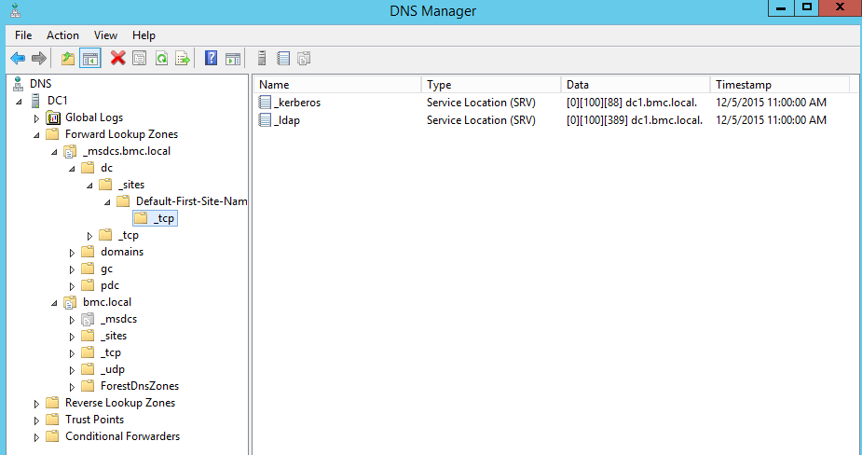
AD & DNS
Geen DNS = Geen Active Directory!
Notes:
Bronvermelding illustratie: eigen werk (screenshot)

Slide 10
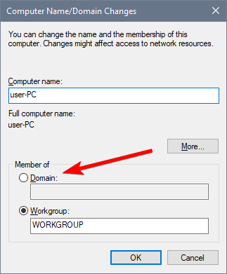
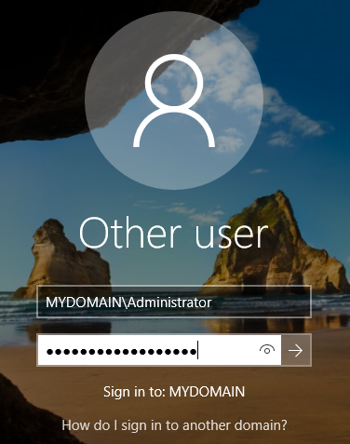
Domain Join
IP & DNS moeten correct ingesteld staan
NETDOM join Server1 /d:bmc.local /reboot
Powershell
Offline Domain Join
Vanaf PC
Add-Computer -ComputerName Server01 -LocalCredential Server01\Administrator -DomainName "domain.com" -OUPath "OU=OU,DC=domain,DC=com" -Credential domain\administrator -Restart -Force
Notes:
Bronvermelding illustraties: eigen werk (screenshots)
offline domain join: de mogelijkheid om een net geautomatiseerde machine direct lid te maken van het domein, we zullen dit in deze cursus verder niet behandelen

Slide 11
Functional Level
Domain Functional Level (DFL)
Functionaliteiten & veiligheid;
(2000, 2003,) 2008, 2008R2, 2012, 2012R2, 2016;
Alleen geldig voor DC!
Forest Functional Levels (FFL)
(2000, 2003,) 2008, 2008R2, 2012, 2012R2, 2016;
DFL > AD UC
FFL > AD Domains and Trust
DFL & FFL ADAC & Powershell
Notes:
DFL/FFL 2000 en 2003 tussen haakjes omdat deze wel bestaan, maar niet meer beschikbaar zijn in Windows Server 2016
Meer details (geen leerstof) op https://docs.microsoft.com/en-us/windows-server/identity/ad-ds/active-directory-functional-levels#windows-server-2003

Slide 12
Sysvol & Files
Shared Folder voor AD
Scripts, GPO
NTFS (Geen ReFS)
Default locatie: C:\Windows\SYSVOL
Sysvol & AD
Verschillende drives
Prestaties & veiligheid
Notes:
Ook in de update van 9 augustus 2018 van https://docs.microsoft.com/en-us/windows-server/identity/ad-ds/deploy/what-s-new-in-active-directory-domain-services-installation-and-removal geeft MS aan geen AD op ReFS te ondersteunen voor database, logfiles en SYSVOL.

Slide 13
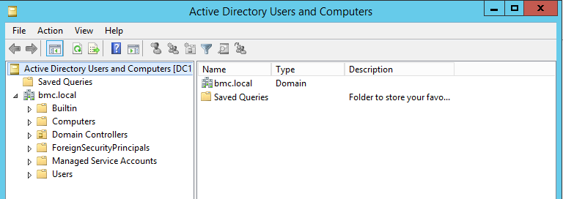
Organizational Unit
Organiseren van objecten in AD
Management dmv Group Policy
Administrative delegation
Aanmaken via: AD UC, ADAC, Powershell
Notes:
Bronvermelding illustratie: eigen werk (screenshot)

Slide 14
What Is a User Account?
A user account is an Active Directory Domain Services (AD DS) object that enables authentication and access to local and network resources
A user account can be stored:
In AD DS (AD DS account)
On the local computer (local account)
AD DS accounts enable log on to domains and provide access to shared network resources
Local accounts enable log on to a single computer and local resources
Creating a user account also creates a Security ID (SID)
Notes:
DC: Alleen bij RODC? Ook local en als je boot into directory services restore mode or recovery console.

Slide 15
Well-Known SIDs
SID: S-1-3-0 Name: Creator Owner Description: A placeholder in an inheritable access control entry (ACE). When the ACE is inherited, the system replaces this SID with the SID for the object's creator.
SID: S-1-5-2 Name: Network Description: A group that includes all users that have logged on through a network connection. Membership is controlled by the operating system.
SID: S-1-5-11 Name: Authenticated Users Description: A group that includes all users whose identities were authenticated when they logged on. Membership is controlled by the operating system.
SID: S-1-5-domain-500 Name: Administrator Description: A user account for the system administrator. By default, it is the only user account that is given full control over the system.

Slide 16
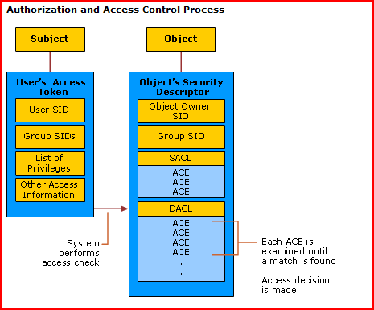
Security ID
Notes:
the discretionary access control list (DACL) – toegang of geen toegang (vergelijk firewall rules)
the system access control list (SACL) – regels met betrekking tot logging/auditing, andere dimensie dan DACL

Slide 17
Names Associated with Domain User Accounts
Object Names | Example | Uniqueness requirement
User logon name | Gregory | Must be unique within domain
User logon name (pre-Microsoft® Windows® 2000) | Woodgrove\Gregory | Must be unique within domain
User principal name (UPN) | Gregory@WoodgroveBank.com | Must be unique within forest
LDAP distinguished name | CN=Gregory,OU=IT,DC= WoodgroveBank,DC=com | Will be globally unique, combining RDN, container name, and domain names
Relative distinguished name (RDN) | CN=Gregory | Must be unique in OU
Notes:
Bij niet unieke logon name: foutmelding “is already in use in this enterprise”.
Distinguished name op tabblad “Attribute Editor” rest op tabblad “Account”

Slide 18
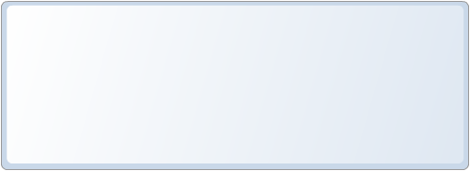
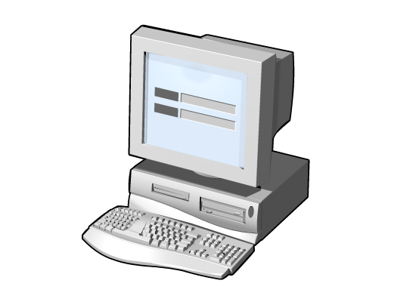

User Account Password Options
User object passwords are a significant aspect of network security and can have options configured for:
Password history
Length
Complexity
By default, Windows Server 2016 domain passwords must meet three out of the following four complexity requirements:
Uppercase
Lowercase
Special characters (e.g. !, $, %, #)
Numbers

Slide 19
Tools for Configuring User Accounts
Local and Domain accounts each have their own tools for creating and managing properties:
Account | Tools
Local computer account | Control Panel\User Accounts\User Accounts
Domain account | Windows Server GUI tool: Active Directory Users and Computers, ADAC Command-line utilities: dsadd, Windows Powershell™, CSVDE, LDIFDE

Slide 20
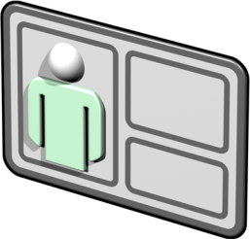

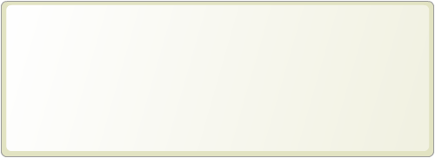
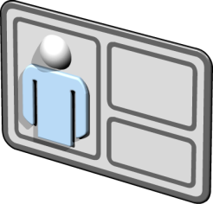
What Is a User Account Template?
A user account template is an account with common properties already configured
User accounts templates take advantage of similarity between user accounts
To use user templates:
Create several typical users reflecting various groups within your organization
Copy the user account most like the new account you want to create
Modify the attributes: names, e-mail address, logon name, etc.

Slide 21
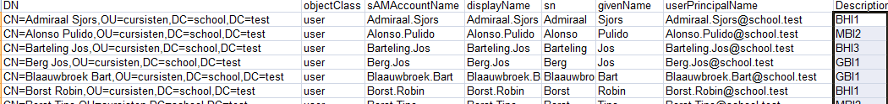
CSVDE
Csvde is a command-line tool that is built into Windows Server
Imports and exports data from Active Directory Domain Services using files that store data in the comma-separated value (CSV) format
csvde command must be run from an elevated command prompt
csvde -i -v -k -F users.csv
Cannot import user passwords (encrypted channel)
No editing or deleting existing objects
Notes:
Dus:
Alleen add
No passwords

Slide 22
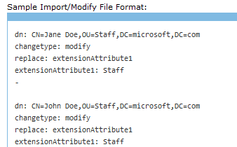
LDIFDE
Commandline tool for importing and exporting objects in AD
A draft Internet standard for a file format that may be used for performing batch operations against directories that conform to the LDAP standards
Difference:
Cross-platform standard
Can modify existing objects and even delete objects
Doesn’t support changing Group Membership
No Passwords
ldifde -i -f user.ldf -s Server2
Notes:
Modify / delete
Standard
Zelfs schema aanpassen.
Passwords kunnen wel, maar dan als replace en met ssl en als base64 encoded unicode string:
dn: CN=Guy Thomas, OU=Birmingham, DC=cp,DC=com changetype: modify replace: unicodePwd unicodePwd::IgBZAG8AdQByAE4AZQB3AFAAdwBkACIA
http://support.microsoft.com/kb/263991

Slide 23

DSADD
Dsadd can add the following objects to Active Directory
User, OU, Group, Computer, Contact, quota
Parameters (user):
UserDN
UPN
Password
Description
Memberof
Homedrv / dir
Profile
<address>
It is available if you have the AD DS server role installed
Elevated command prompt
If a value that you supply contains spaces, use quotation marks around the text.
use the special token $username$ to replace the SAM account name in the value of the -email, -hmdir, -profile, and -webpg parameters
Notes:
-hmdir\users\Denise\home OF hmdir\users\$username$\home

Slide 24
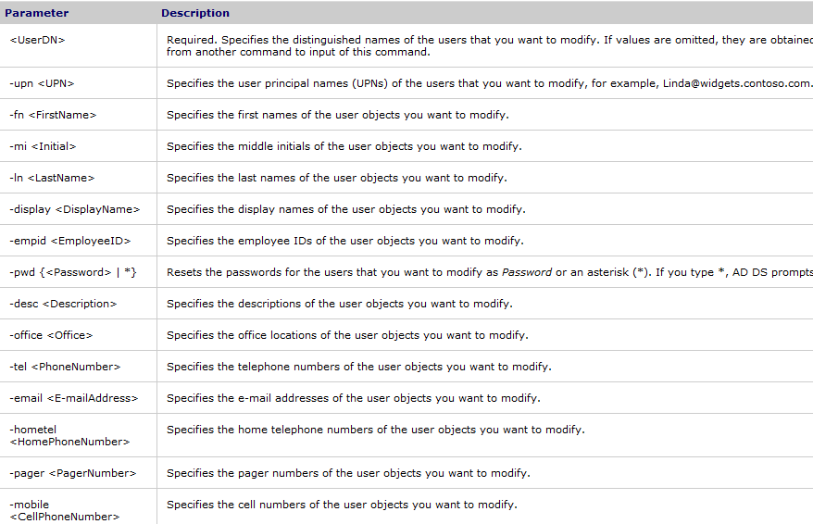
DSMOD
Dsmod modifies an existing object in AD. Objects can be:
Computer, group, ou, user, server, …

Slide 25
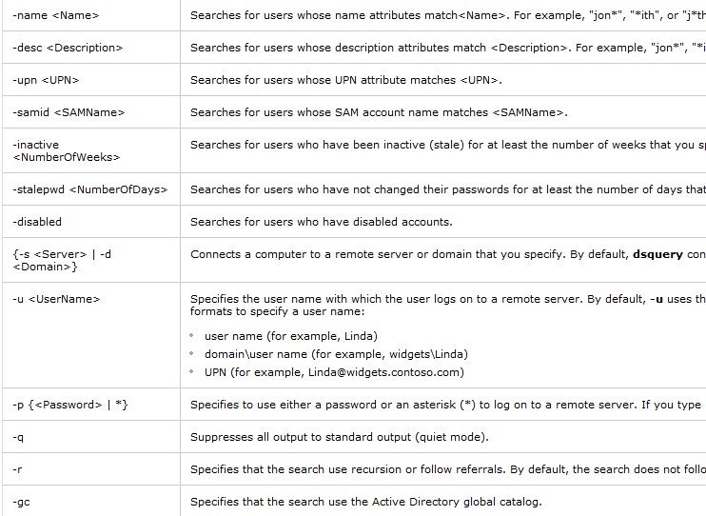
DSQuery
Finds users in the directory who match the search criteria that you specify
Notes:
Examples:
To find all computers that have been inactive for the last four weeks and
remove them from the directory:
dsquery computer -inactive 4 | dsrm
To find all users in the organizational unit
"ou=Marketing,dc=microsoft,dc=com" and add them to the Marketing Staff group:
dsquery user ou=Marketing,dc=microsoft,dc=com | dsmod group
"cn=Marketing Staff,ou=Marketing,dc=microsoft,dc=com" -addmbr
To find all users with names starting with "John" and display his office
number:
dsquery user -name John* | dsget user -office
To display an arbitrary set of attributes of any given object in the
directory use the dsquery * command. For example, to display the
sAMAccountName, userPrincipalName and department attributes of the object
whose DN is ou=Test,dc=microsoft,dc=com:
dsquery * ou=Test,dc=microsoft,dc=com -scope base
-attr sAMAccountName userPrincipalName department
To read all attributes of the object whose DN is ou=Test,dc=microsoft,dc=com:
dsquery * ou=Test,dc=microsoft,dc=com -scope base -attr *
Directory Service command-line tools help:
dsadd /? - help for adding objects.
dsget /? - help for displaying objects.
dsmod /? - help for modifying objects.
dsmove /? - help for moving objects.
dsquery /? - help for finding objects matching search criteria.
dsrm /? - help for deleting objects.
PS C:\Users\Administrator> dsquery user "OU=ouRienkTest,DC=school,DC=test"
"CN=henk henk,OU=ouRienkTest,DC=school,DC=test"
"CN=Kareltje Schaafsma,OU=ouRienkTest,DC=school,DC=test“

Slide 26
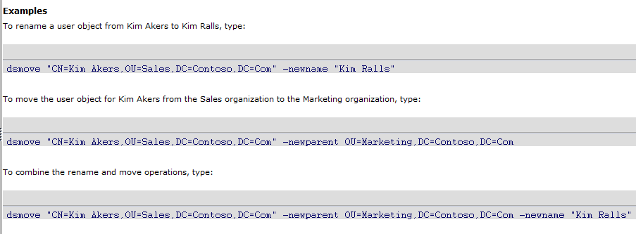
DSmove
Moves a single object, within a domain, from its current location in the directory to a new location, or renames a single object without moving it in the directory tree

Slide 27
PowerShell
Bijvoorbeeld: Maak een OU en importeer daarna je gebruikers met wachtwoord en enabled:
Install-WindowsFeature rsat-adds
New-ADOrganizationalUnit studenten
import-csv c:\powershell\source\users.csv |
New-ADUser
Notes:
PS C:\Users\Administrator\Desktop> type .\wsh.vbs
Wscript.Echo "hoi"
PS C:\Users\Administrator\Desktop> cscript.exe .\wsh.vbs
hoi
PS C:\Users\Administrator\Desktop> wscript.exe .\wsh.vbs
<window met hoi>

Slide 28
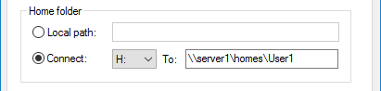
Homefolders
Home folder is an additional folder that can be used to store personal documents
Can be stored on client computer or on a file server
It’s not part of a profile so size doesn’t effect network traffic
Advantages:
Gain access to files from any client
Centralized Backup
Notes:
Profile tab

Slide 29
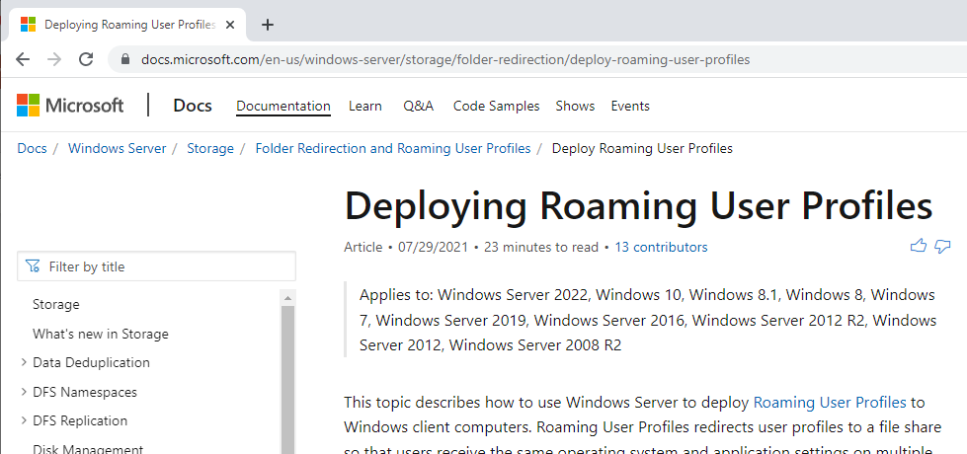
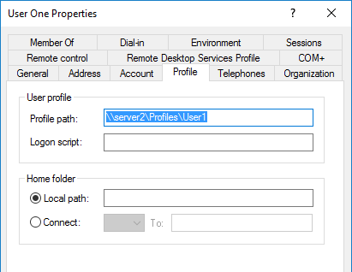
Profile
Collection of folders and data of the user’s current desktop environment, application settings and personal data.
Three types:
Local
Roaming
Mandatory
Notes:
As a reminder, here's how the roaming profile works. The user logs on, the profile is retrieved from the server where it's stored, and then the profile is copied down to the local computer. When the user logs off, any changes to the profile are copied back up to the server where the roaming profile is stored.
Mandatory profile == roaming, maar dan geconfigureerd als read only.
Windows Vista and 7 will get their profile stored on the server with .V2 added (example: \\server\profiles\username.V2)
At first logon, a folder will typically be created under "Documents and Settings" (standard folder on English version of Windows 2000, XP and Windows Server 2003) matching the logon name of the user. Should a folder of that name already exist, the profile-creation process will create a new one, typically named username.computername, on workgroup computers, or username.domainname on Active Directory member computers.
The new profile is created by making a copy of a special profile named Default User. It is permissible to modify this Default User profile
Profile contents
"NTUSER.DAT" - Within the root of the profile
"My Documents" - This folder is intended to contain the user's work
Favorites
Start menu
Desktop
Background
Application data (bv recent files opened)
"All Users" - This profile is present mainly to answer an issue related to software installation. It provides a way for setup programs to create desktop or start-menu shortcuts. "All Users" acts purely as an information-store, it is never loaded as an active profile.

Slide 30
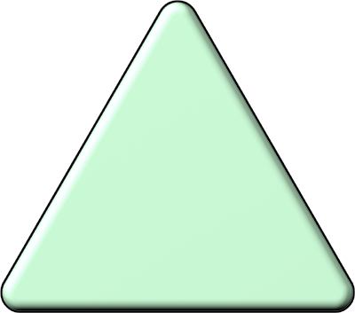


What Is a Computer Account?
A computer account is an object in
AD DS that identifies a computer
in a domain
Computer accounts:
Are required for authentication and auditing
Enable managing computer by using group policies
Are required for all computers running Windows NT or later

Slide 31
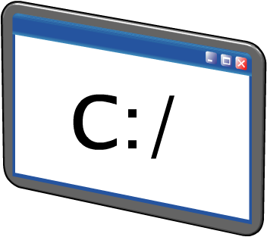

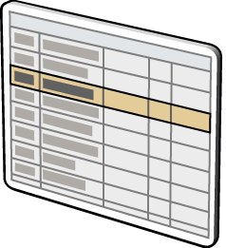
Options for Locating Objects in AD DS
Sorting: use column headings in Active Directory Users and Computers to find the objects based on the columns
Searching: provide the criteria for which you want to search
Command line: dsquery parameter
Notes:
Active directory users and computers: loopje...
To find all users with names starting with "John"
dsquery user -name John*
To find all computers that have been inactive for the last four weeks
dsquery computer -inactive 4

Slide 32
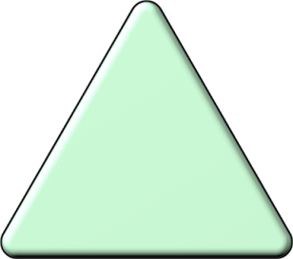

What is an OU?
OUs are used to:
An organizational unit (OU):
Is a directory object within the domain
Is the smallest scope or unit to which you can assign Group Policy settings or delegate administrative authority
Can contain users, computers, groups, printers, and other OUs
Delegate authority (create users, reset passwords)
Create containers within the domain model to represent logical structures
Create administrative boundaries within the domain
Enforce Group Policy

Slide 33

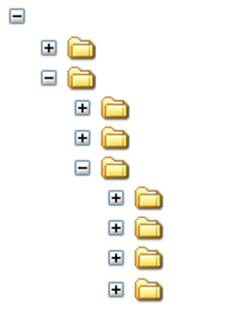

What Is an OU Hierarchy?
OUs can be put inside other OUs to create a hierarchical design
WoodgroveBank.com
Builtin
Business Units
Business Management
Delegation
Product Development
Accounts
Delegation
Resources
Security Groups

Slide 34
OU Hierarchy Examples
Example | Benefit
Geographic OUs | Can be administered at the location level
Departmental OUs | Delegation by job function
Resource OUs | Designed to manage resource (nonuser) objects
By management | Build OUs around the administration of the business
Notes:
Resource OUs: will host resources that users will need to access domain, bv computer accounts, file shares, contacts.

Slide 35
Vragen?
?
Notes:
Bronvermelding illustratie: zelf gemaakte WordArt

